Slide 1

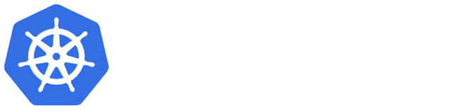
Kubernetes Training

Slide 2
Kubernetes Training: Day 3
Building a cluster from scratch
Lunch Break
Introduction to observability
Logging
Monitoring
Exercises

Slide 3
I - Building a cluster from scratch

Slide 4
Let’s begin!
IP Ranges:
Bare metal nodes: 172.31.16.0/20
Starting setup: We will use a simple one for this course
Pods: 10.32.0.0/16
Services: 10.200.0.0/24
Host OS
Host OS
Host OS
Controller
Worker1
Worker2
(172.31.16.2)
(172.31.16.3)
(172.31.16.4)

Slide 5

Question
We will install several components, how to securely determine which of them actually belong to the cluster?
Cluster authority
Host OS
Host OS
Host OS
Controller
Worker1
Worker2
(172.31.16.2)
(172.31.16.3)
(172.31.16.4)

Slide 6
Cluster authority
Components communicate using TLS certificates.
The cluster Certificate Authority (CA) will be responsible of creating these certificates.
This will be later used for user authentication
Possible options for creating the CA:
OpenSSL
CloudFlare's PKI toolkit

Slide 7
Cluster authority: Steps
Create CA private key
openssl genrsa -out /etc/kubernetes/pki/ca.key 2048
Create self-signed CA certificate
openssl req -x509 -new -nodes -key /etc/kubernetes/pki/ca.key -days 10000 -out /etc/kubernetes/pki/ca.crt -subj "/CN=Kubernetes/O=Kubernetes"

Slide 8

Starting with the control plane
Kubernetes needs a storage backend for the cluster status
Cluster authority
etcd
Host OS
Host OS
Host OS
Controller
Worker1
Worker2
(172.31.16.2)
(172.31.16.3)
(172.31.16.4)

Slide 9
etcd
Distributed key value store that provides a reliable way to store data across a cluster of machines
Will store the state of the Kubernetes cluster
Should be backed up periodically
Access to etcd is equivalent to root permission in the cluster so ideally only the API server should have access to it (explained later)

Slide 10
etcd: Steps (I)
Generate the following certificates using the cluster authority:
Server certificate: Used to validate the etcd cluster
NOTE: The certificate must contain the addresses used to access etcd
Client certificate: Used by clients to connect to the etcd cluster
Download etcd
Extract etcd tarball

Slide 11
etcd: Steps (II)
Launch etcd
etcd
Name of the cluster
--name etcd-cluster
--cert-file=/path/to/etcd.crt
--key-file=/path/to/etcd.key
Server certificate
--trusted-ca-file=/path/to/ca.crt
--client-cert-auth
Client authentication
--advertise-client-urls https://IP:2379,https://127.0.0.1:2379
--listen-client-urls https://IP:2379,https://127.0.0.1:2379
Where it will listen to requests
--data-dir=/var/lib/etcd
Data directory

Slide 12
WAIT!
We want etcd to start at boot
We want etcd to auto-restart if failures occur
We want to supervise and control the process
We want etcd logs to be accessible in the system journal
Solution: create a systemd service for etcd.
Init system used in major Linux distributions: Clear Linux, Ubuntu, RedHat, Fedora, CentOS…

Slide 13
etcd systemd service
[Unit]
Description=etcd
Documentation=https://github.com/coreos
Information about the service
[Service]
ExecStart=/usr/local/bin/etcd \\
--name etcd-cluster \\
--cert-file=/path/to/etcd.crt \\
--key-file=/path/to/etcd.key \\
--trusted-ca-file=/path/to/ca.crt \\
--client-cert-auth \\
--advertise-client-urls https://IP:2379,https://127.0.0.1:2379 \\
--listen-client-urls https://IP:2379,https://127.0.0.1:2379 \\
--data-dir=/var/lib/etcd
Restart=on-failure
RestartSec=5
Command to execute
and restart policies
[Install]
WantedBy=multi-user.target
When to execute. Dependencies

Slide 14
Basic systemctl usage
We will store our services in this folder
/etc/systemd/system
Make service start at boot:
systemctl enable servicename.service # the .service part is optional
Start service:
systemctl start servicename.service
Check status
Check Logs
systemctl status servicename.service
journalctl -u servicename.service
When changing a service file, execute this command
systemctl daemon-reload

Slide 15
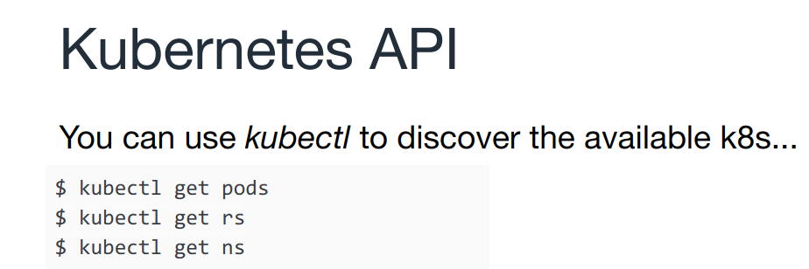

Contuining with the Control Plane
(Flashback from session 1)
Kubernetes needs a server to handle API requests
Cluster authority
etcd
kube-apiserver
Host OS
Host OS
Host OS
Controller
Worker1
Worker2
(172.31.16.2)
(172.31.16.3)
(172.31.16.4)

Slide 16
kube-apiserver
Exposes the Kubernetes API. It is the front-end for the Kubernetes control plane.
Uses etcd to store the cluster status. It’s the only component that accesses the data store.
The rest of the components of the cluster will query kube-apiserver to obtain information.
Performs cluster operations like assigning Service IPs, NodePort assignations or RBAC management
Supports High Availability

Slide 17
kube-apiserver: steps
Generate the following certificates using the cluster authority:
Server certificate: Used to validate the API server.
NOTE: The certificate must contain the addresses used to access kube-apiserver
Download and install kube-apiserver
Create kube-apiserver systemd service

Slide 18
kube-apiserver command
kube-apiserver
--tls-cert-file=${KUBE_APISERVER_CERT_PATH}
--tls-private-key-file=${KUBE_APISERVER_KEY_PATH}
Server certificate
--client-ca-file=${KUBERNETES_CA_CERT_PATH}
Client authentication
--etcd-cafile=${KUBERNETES_CA_CERT_PATH}
--etcd-certfile=${ETCD_CLIENT_CERT_PATH}
--etcd-keyfile=${ETCD_CLIENT_KEY_PATH}
--etcd-servers=https://${CONTROLLER_PRIVATE_IP}:2379
Connection with etcd
--service-cluster-ip-range=${SERVICE_CLUSTERIP_NET}
Service IP Range
Enable RBAC
--authorization-mode=RBAC
Verbose level
--v=2

Slide 19
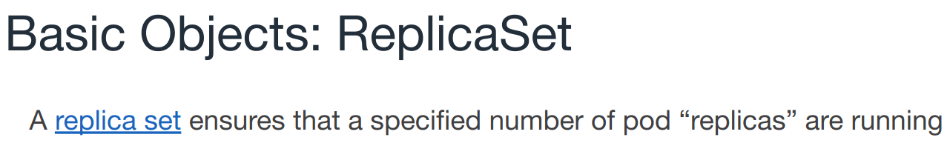

Contuining with the Control Plane
(Flashback from session 1)
Kubernetes needs to control the expected status of the cluster
Cluster authority
etcd
kube-apiserver
kube-controller-manager
Host OS
Host OS
Host OS
Controller
Worker1
Worker2
(172.31.16.2)
(172.31.16.3)
(172.31.16.4)

Slide 20





kube-controller-manager
It is comprised of a set of controllers that monitor different parts of the cluster
ReplicaSet
Node Controller
Replication Controller
ServiceAccount & Token Controller
172.100.3.3:8080
172.100.3.4:8080
...
wordpress
Endpoint Controller
Garbage Collector

Slide 21
kube-controller-manager: steps
Create kube-controller manager certificates:
Accessing kube-apiserver
Generating service account tokens
Create kubeconfig to access kube-apiserver
Download and install kube-controller manager
Create kube-apiserver systemd service

Slide 22
kube-controller-manager command
kube-controller-manager
--cluster-name=kubernetes
Cluster name
Kubeconfig file for accessing kube-apiserver
--kubeconfig=${KUBE_CONTROLLER_MANAGER_KUBECONFIG_PATH}
--use-service-account-credentials=true
--service-account-private-key-file=${SERVICE_ACCOUNT_GEN_KEY_PATH}
--root-ca-file=${KUBERNETES_CA_CERT_PATH}
Service account token generation
--v=2
Verbose level

Slide 23
kube-apiserver command (updated)
kube-apiserver
--tls-cert-file=${KUBE_APISERVER_CERT_PATH}
--tls-private-key-file=${KUBE_APISERVER_KEY_PATH}
Server certificate
--client-ca-file=${KUBERNETES_CA_CERT_PATH}
Client authentication
--etcd-cafile=${KUBERNETES_CA_CERT_PATH}
--etcd-certfile=${ETCD_CLIENT_CERT_PATH}
--etcd-keyfile=${ETCD_CLIENT_KEY_PATH}
--etcd-servers=https://${CONTROLLER_PRIVATE_IP}:2379
Connection with etcd
--service-cluster-ip-range=${SERVICE_CLUSTERIP_NET}
Service IP Range
Enable RBAC
--authorization-mode=RBAC
Verbose level
--v=2
--service-account-key-file=${SERVICE_ACCOUNT_GEN_CERT_PATH}
Service account generation

Slide 24

Continuing with the Control Plane
Kubernetes needs to orchestrate pods to run on the worker nodes
Cluster authority
etcd
kube-apiserver
kube-controller-manager
kube-scheduler
Host OS
Host OS
Host OS
Controller
Worker1
Worker2
(172.31.16.2)
(172.31.16.3)
(172.31.16.4)

Slide 25
kube-scheduler
Watches newly created pods that have no node assigned, and selects a node for them to run on.
Communicates with kube-apiserver
Takes into account affinity, hardware/software constraints, data locality, deadlines...

Slide 26
kube-scheduler: steps
Create kube-controller manager certificates:
Accessing kube-apiserver
Create kubeconfig to access kube-apiserver
Download and install kube-scheduler
Create kube-scheduler systemd service

Slide 27
kube-scheduler command
kube-scheduler
--kubeconfig=${KUBE_SCHEDULER_KUBECONFIG_PATH}
Kubeconfig file for accessing kube-apiserver
--v=2
Verbose level

Slide 28

Let’s go with the workers
The workers need to be able to run containers
Cluster authority
kubelet
kubelet
etcd
kube-apiserver
kube-scheduler
kube-controller-manager
Host OS
Host OS
Host OS
Controller
Worker1
Worker2
(172.31.16.2)
(172.31.16.3)
(172.31.16.4)

Slide 29
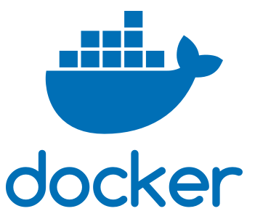



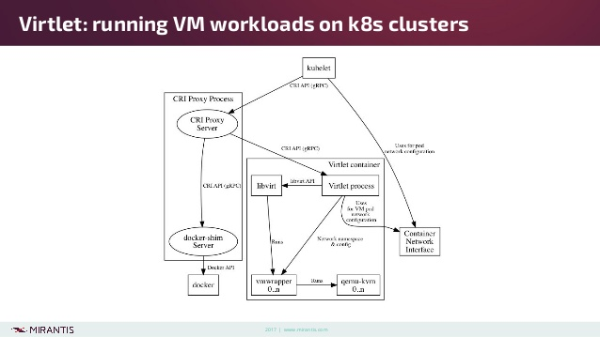

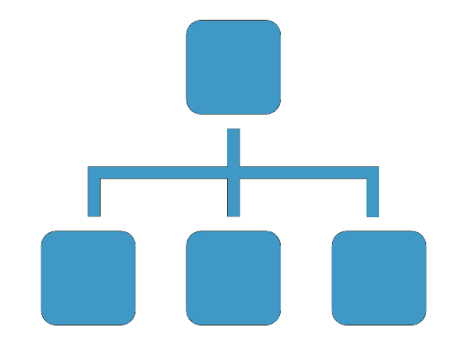
kubelet
Makes sure that containers are running in a pod.
Uses kube-apiserver to know which pods must run at any moment.
kube-apiserver accesses kubelet for operations like logs or exec
Two important requirements:
172.100.3.3
172.100.3.3
kubenet
Container Runtime Interface (CRI) implementation
Which runtime will we use to execute containers?
Network Plugin
How will the container network be implemented?

Slide 30
kubelet: steps (on each worker node)
Create kube-controller manager certificates:
Accessing kube-apiserver
Create kubeconfig to access kube-apiserver
Download and install docker
Download and install cni components
Download and install kubelet
Create kubelet systemd service

Slide 31
kubelet command
kubelet
--kubeconfig=${KUBELET_KUBECONFIG_PATH}
Kubeconfig file for accessing kube-apiserver
--container-runtime=docker
Which container runtime to use
--network-plugin=cni
--cni-conf-dir=/etc/cni/net.d
--cni-bin-dir=/opt/cni/bin
Which network plugin to use
--client-ca-file=${KUBERNETES_CA_CERT_PATH}
Client access (kube-apiserver basically)
--v=2
verbose

Slide 32
kube-apiserver command (updated)
kube-apiserver
--tls-cert-file=${KUBE_APISERVER_CERT_PATH}
--tls-private-key-file=${KUBE_APISERVER_KEY_PATH}
Server certificate
--client-ca-file=${KUBERNETES_CA_CERT_PATH}
Client authentication
--etcd-cafile=${KUBERNETES_CA_CERT_PATH}
--etcd-certfile=${ETCD_CLIENT_CERT_PATH}
--etcd-keyfile=${ETCD_CLIENT_KEY_PATH}
--etcd-servers=https://${CONTROLLER_PRIVATE_IP}:2379
Connection with etcd
--service-cluster-ip-range=${SERVICE_CLUSTERIP_NET}
Service IP Range
--authorization-mode=RBAC
,Node
Enable RBAC
and Kubelet access
Verbose level
--v=2
--service-account-key-file=${SERVICE_ACCOUNT_GEN_CERT_PATH}
Service account generation

Slide 33

Let’s go with the workers
Containers still cannot communicate
Cluster authority
kubelet
Pod
kubelet
etcd
docker
docker
kube-apiserver
cni
Plugin
cni
Plugin
kube-scheduler
kube-controller-manager
Host OS
Host OS
Host OS
CNI provides an interface, not the pod networking itself
Controller
Worker1
Worker2
(172.31.16.2)
(172.31.16.3)
(172.31.16.4)

Slide 34






CNI Plugins
Plugin
Responsible for inserting a network interface into the container network namespace (e.g. one end of a veth pair).
Will make changes on the host (e.g. attaching the other end of the veth into a bridge), so the container should be privileged.
Different options to select, each of them providing different features, such as:
L3 routing
vxlan
Monitoring

Slide 35
Weave plugin: steps
Deploy using this command
$ kubectl apply -f "https://cloud.weave.works/k8s/net?k8s-version=$(kubectl version | base64 | tr -d '\n')"
This will deploy a DaemonSet with the privileged containers.
Check that the Pods get deployed. Does it work?

Slide 36
kubelet command (updated)
kubelet
--kubeconfig=${KUBELET_KUBECONFIG_PATH}
Kubeconfig file for accessing kube-apiserver
--container-runtime=docker
Which container runtime to use
--network-plugin=cni
--cni-conf-dir=/etc/cni/net.d
--cni-bin-dir=/opt/cni/bin
Which network plugin to use
--client-ca-file=${KUBERNETES_CA_CERT_PATH}
Client access (kube-apiserver basically)
--v=2
verbose
--allow-privileged=true
use privileged containers

Slide 37
kube-apiserver command (updated)
kube-apiserver
--tls-cert-file=${KUBE_APISERVER_CERT_PATH}
--tls-private-key-file=${KUBE_APISERVER_KEY_PATH}
Server certificate
--client-ca-file=${KUBERNETES_CA_CERT_PATH}
Client authentication
--etcd-cafile=${KUBERNETES_CA_CERT_PATH}
--etcd-certfile=${ETCD_CLIENT_CERT_PATH}
--etcd-keyfile=${ETCD_CLIENT_KEY_PATH}
--etcd-servers=https://${CONTROLLER_PRIVATE_IP}:2379
Connection with etcd
--service-cluster-ip-range=${SERVICE_CLUSTERIP_NET}
Service IP Range
--authorization-mode=RBAC
,Node
Enable RBAC
and Kubelet access
Verbose level
--v=2
--service-account-key-file=${SERVICE_ACCOUNT_GEN_CERT_PATH}
Service account generation
--allow-privileged=true
Use privileged containers

Slide 38
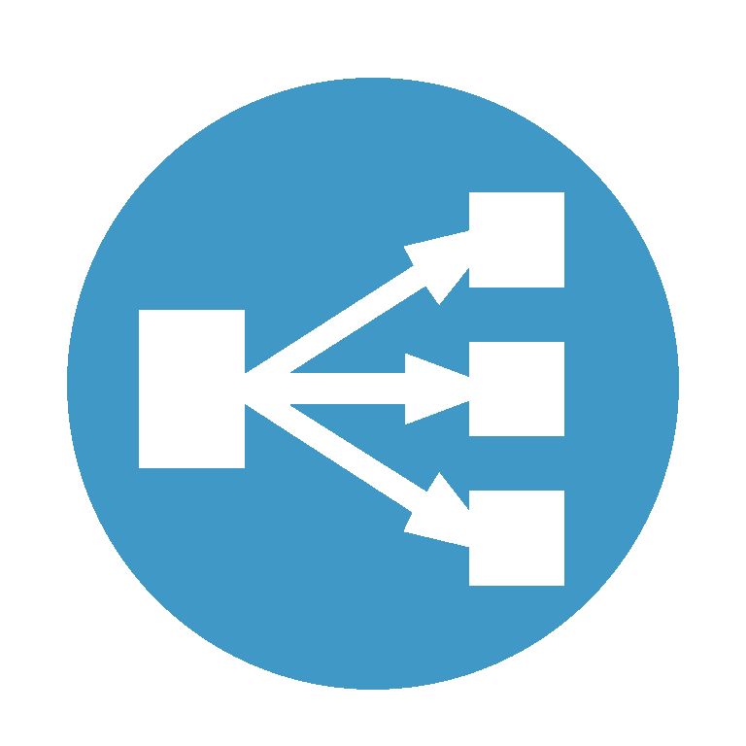
Let’s go with the workers
We need service abstractions to work
Cluster authority
kubelet
kubelet
etcd
docker
docker
kube-apiserver
cni
cni
kube-scheduler
kube-proxy
kube-proxy
kube-controller-manager
Host OS
Host OS
Host OS
Controller
Worker1
Worker2
(172.31.16.2)
(172.31.16.3)
(172.31.16.4)

Slide 39
kube-proxy
Reflects services as defined in the Kubernetes API on each node.
Can do simple TCP and UDP stream forwarding
Uses iptables under the hood

Slide 40
kube-proxy: steps
Create kube-controller manager certificates:
Accessing kube-apiserver
Create kubeconfig to access kube-apiserver
Install iptables
Download and install kube-proxy
Create kube-proxy systemd service

Slide 41
kube-proxy command
kube-proxy
--kubeconfig=${KUBE_PROXY_KUBECONFIG_PATH}
Kubeconfig file for accessing kube-apiserver
verbose
--v=2

Slide 42
Done with the basic component setup!
Easy, huh?
Cluster authority
kubelet
kubelet
etcd
docker
docker
kube-apiserver
cni
cni
kube-scheduler
kube-proxy
kube-proxy
kube-controller-manager
Host OS
Host OS
Host OS
Controller
Worker1
Worker2
(172.31.16.2)
(172.31.16.3)
(172.31.16.4)

Slide 43

Let’s add components
Shall we start with Helm?
Cluster authority
etcd
kube-apiserver
Tiller
kube-scheduler
Pods
Pods
kube-controller-manager
Host OS
Host OS
Host OS
Controller
Worker1
Worker2
(172.31.16.2)
(172.31.16.3)
(172.31.16.4)

Slide 44

Flashback
Tiller
Create a Tiller ServiceAccount
kind: ClusterRoleBinding apiVersion: rbac.authorization.k8s.io/v1 metadata: name: tiller-rolebinding subjects: - kind: ServiceAccount name: tiller-sa # Name is case sensitive apiGroup: rbac.authorization.k8s.io roleRef: kind: ClusterRole name: cluster-admin apiGroup: rbac.authorization.k8s.io
apiVersion: v1 kind: ServiceAccount metadata: name: tiller-sa
Set up RBAC for Tiller
Which operations requires Tiller?
In principle, it can deploy ANYTHING in ANY NAMESPACE

Slide 45
This should be easy
Tiller
Install tiller
helm init --service-account tiller --upgrade
Let’s deploy WordPress
helm install stable/wordpress
It works… does it?

Slide 46

Helm works, but we cannot fully deploy a Wordpress chart
We need dynamic volume provisioning
Cluster authority
etcd
kube-apiserver
Tiller
kube-scheduler
Pods
Pods
kube-controller-manager
Host OS
Host OS
Host OS
Controller
Worker1
Worker2
(172.31.16.2)
(172.31.16.3)
(172.31.16.4)

Slide 47
Dynamic storage provisioner
Listens to PersistentVolumeClaims and creates the proper PersistentVolume objects
Will need RBAC
Several providers available to install in any cluster
NFS
GlusterFS
CephFS
...

Slide 48
This should be easy (part 2)
Deploy the NFS provisioner chart
helm install stable/nfs-server-provisioner --name nfs-provisioner --namespace kube-system --set storageClass.defaultClass=true
Let’s deploy WordPress now
helm install stable/wordpress
It works… WHY DOESN’T IT WORK?

Slide 49
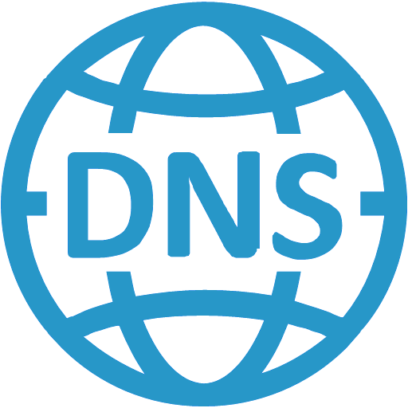
Helm works, but we cannot fully deploy a Wordpress chart
We also need service DNS resolution
Cluster authority
etcd
kube-apiserver
Tiller
kube-scheduler
Pods
Pods
kube-controller-manager
Host OS
Host OS
Host OS
Controller
Worker1
Worker2
(172.31.16.2)
(172.31.16.3)
(172.31.16.4)

Slide 50
kube-dns
Pod and Service that containers will use for DNS resolution.
Based on SkyDNS
Requires a static service IP address
Comprised of three containers
Adds DNS caching to improve performance
Watches for changes in Services and Endpoints
dnsmasq
kubedns
Maintains in-memory lookup structures to serve DNS requests
Health check endpoint
sidecar

Slide 51
This should be easy (part 3)
Download template files from: https://github.com/kubernetes/kubernetes/tree/master/cluster/addons/dns
Generate the YAMLs
Deploy the YAMLs
Try redeploying the chart… REALLY? NOT YET?

Slide 52
kubelet command (updated)
kubelet
--kubeconfig=${KUBELET_KUBECONFIG_PATH}
Kubeconfig file for accessing kube-apiserver
--container-runtime=docker
Which container runtime to use
--network-plugin=cni
--cni-conf-dir=/etc/cni/net.d
--cni-bin-dir=/opt/cni/bin
Which network plugin to use
--client-ca-file=${KUBERNETES_CA_CERT_PATH}
Client access (kube-apiserver basically)
--v=2
verbose
--allow-privileged=true
use priveleged containers
DNS settings
--cluster-dns=$KUBE_DNS_SERVICE_IP --cluster-domain=$CLUSTER_DOMAIN

Slide 53

This should be easy (part 4)
Let’s try again with WordPress now
helm install stable/wordpress
But… what about Ingress?

Slide 54

Seriously, this is the last bit
We also want Ingress rules
Cluster authority
etcd
kube-apiserver
Tiller
kube-scheduler
Pods
kube-controller-manager
Host OS
Host OS
Host OS
Controller
Worker1
Worker2
(172.31.16.2)
(172.31.16.3)
(172.31.16.4)

Slide 55



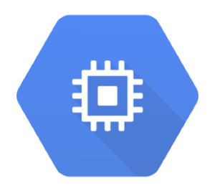
ingress-controller
Listens to ingress rules and auto-reconfigures itself.
Several controllers available
Available as a helm chart!
For our case, we will need the pod to be privileged

Slide 56

This should be easy (part 5)
Install ingress-controller helm chart
helm install stable/nginx-ingress --name nginx-ingress --set rbac.create=true --namespace kube-system --set controller.hostNetwork=true --set controller.kind=DaemonSet
Let’s try again with WordPress now
helm install stable/wordpress --set ingress.enabled=true
We did it!!

Slide 57

Recap: What if something goes wrong?
Pods are not being scheduled to all nodes
A node starts malfunctioning
Pods are not getting IPs
DNS is not accessible
Services are not redirecting properly
A node is not being detected
Cluster authority
etcd
kube-apiserver
Tiller
kube-scheduler
Pods
Pods
kube-controller-manager
Host OS
Host OS
Host OS
Controller
Worker1
Worker2
(172.31.16.2)
(172.31.16.3)
(172.31.16.4)

Slide 58
Some useful steps
Check the systemd logs from all the k8s services. Example:
journalctl -u kubelet
Do the same with the important pods in your system
kubectl logs -n kube-system kube-dns kubedns
If a specific node is failing, make sure you move all the load to other nodes in the cluster
kubectl drain node-1
You can also add some monitoring tools
TO BE CONTINUED...

Slide 59
Part 2: Monitoring and Logging

Slide 60
I - Introduction

Slide 61
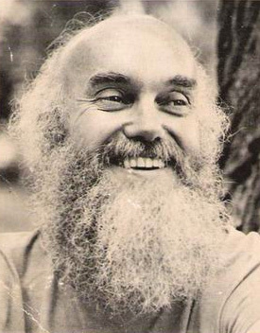
Introduction
Observability
Information is just bits of data. Knowledge is putting them together. Wisdom is transcending them. -- Ram Dass, 2015

Slide 62

Introduction
Observability
Data is what we collect and store. It becomes information once we analyze it. It becomes knowledge once we understand it. -- @kelseyhightower, 2018

Slide 63

Introduction
Observability
Those f*elasticsearch JVMs are eating all our resources. -- me, now.

Slide 64
Introduction
Observability
Broad concept, with variety of tools and methodologies
In common: trying to capture the internal state of a running service, and their mesh with others (microservices, in particular)
3× core aspects
Monitoring
Logging
Tracing

Slide 65
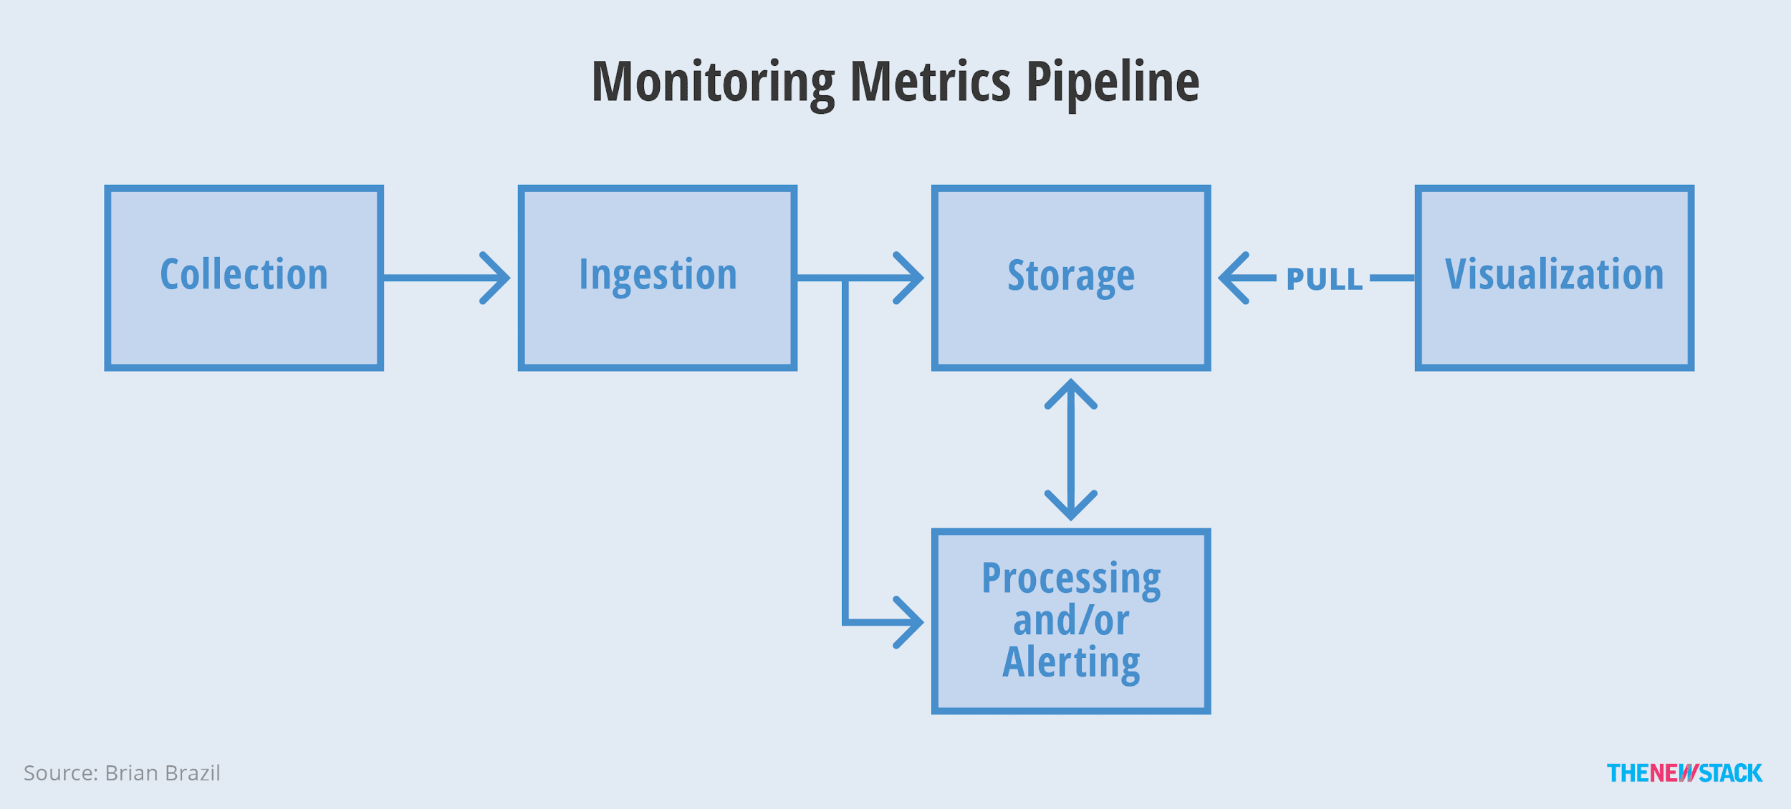
Observability -> Monitoring
Gathering and aggregating application metrics in a meaningful way, for:
alerting: know when things go wrong
trending: query/visualize them, track SLI for SLA/SLO
debugging: correlating events aggregations (e.g. backend latency spike driving 500s on some services)

Slide 66
Observability -> Logging
Storing application, request, transaction, debug logs for
auditing: may actually be required for biz purposes
analysis: manually digging into logs, typical debugging
visualization: from aggregated queries
UI / API
Query
N × logs
Parse
Buffer
Inject
Data Store

Slide 67
Observability -> Tracing
Storing end-to-end requests flow events in a distributed system, for
debugging: per query tracing
continuous profiling
detecting anomalies: e.g. always storing latency outliers
total: 200ms
frontend: 25ms
db1 query: 50ms
db2 query: 125ms
response: 50ms

Slide 68
II - Logging
Deploying and using the EFK stack

Slide 69
Observability -> Logging
Where from ...
transactions: Create-Read-Update-Delete
requests: e.g. http logs
applications: INFO, WARN, DEBUG
debug traces: e.g. exceptions dumps
less structured

Slide 70
Logging
How?
Storing log payloads, which can be:
plaintext (aka loglines)
structured (e.g. json)
binary (e.g. protobuf, systemd journal logs)
Logging pipeline challenges:
high volume traffic and storage
multi-dimensional (multi-field)
UI / API
Query
N × logs
Parse
Buffer
Inject
Data Store

Slide 71
Logging stacks
Poor-man’s:
tail -f /var/log/*.log | egrep -i ‘Error|Fatal’
Some distributed ones, available as F/OSS(~ish):
Influxdb and friends (TICK)
Graylog (Elasticsearch + MongoDB + Graylog Server and webUI)
ELK: Elasticsearch + Logstash + Kibana
EFK: Elasticsearch + Fluentd + Kibana
we’ll explore this one for Kubernetes

Slide 72



Logging with the EFK stack
E is for Elephant? … ah no ...
Elasticsearch: Database + Fluentd: Log collector + Kibana: Visualization
elasticsearch-logging:9200
node1
logs
node2
logs
node3
logs

Slide 73
Deploy the EFK stack on k8s
… aka unleash the elephants !
# If you already have it, just `cd …` as per below and `git pull` $ git clone https://github.com/bitnami-labs/k8s-training-resources $ cd k8s-training-resources/session-04/logging $ kubectl create ns logging $ kubectl apply -f es-service.yaml,fluentd-es-configmap.yaml,kibana-service.yaml $ kubectl apply -f es-statefulset.yaml,fluentd-es-ds.yaml,kibana-deployment.yaml $ kubectl get pod --namespace=logging NAME READY STATUS RESTARTS AGE elasticsearch-logging-0 1/1 Running 0 6m elasticsearch-logging-1 1/1 Running 0 6m fluentd-es-v2.0.4-bwzr6 1/1 Running 0 6m kibana-logging-5654db47bd-f2fkf 1/1 Running 0 6m $ kubectl get svc --namespace=logging <...>

Slide 74
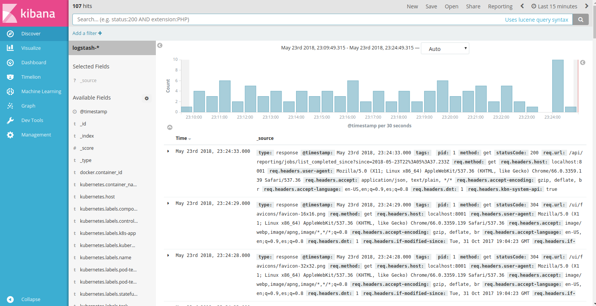
Kibana logging UI
Hello, a human here talking clicking ...
$ kubectl proxy, then visit http://localhost:8001/api/v1/namespaces/logging/services/kibana-logging/proxy

Slide 75
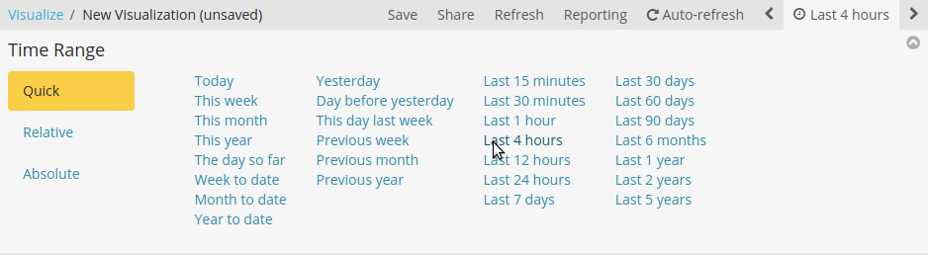
Kibana logging
Now select a wider timespan:
Go up-right
Select time -> [Quick] -> Last 4 hours

Slide 76
Kibana logging
Discover … how to query the thing ...
Some example queries:
"kube-apiserver"
kubernetes.container_name: "kube-apiserver"
kubernetes.namespace_name: "kube-system"
kubernetes.namespace_name: "kube-system" AND stream: stderr
log: *err*
log: /.*err.*/
@timestamp:[now-5m TO now]
Be sure to cleanup the query bar: remove string and click 🔍, and let’s =>

Slide 77
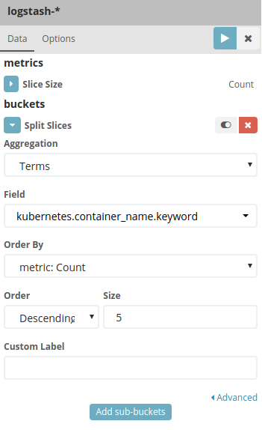
Kibana logging
Visualize ...
[ Visualize ] -> [ Create Visualization ] -> [ Pie ]
Index: logstash-*
Split-slices
Aggregation: Terms
Field: kubernetes.container_name.keyword
[Play]

Slide 78
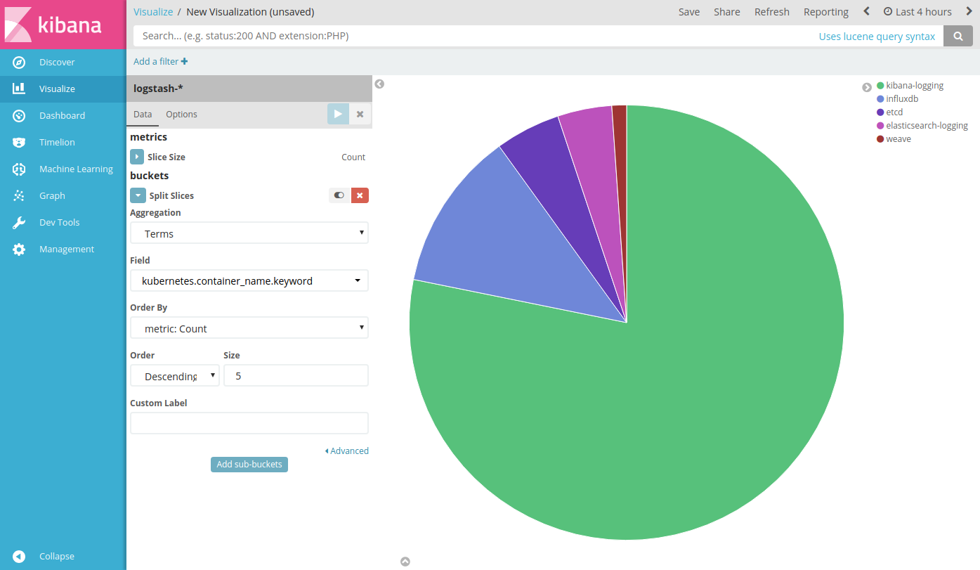
Kibana logging
… A pie !

Slide 79
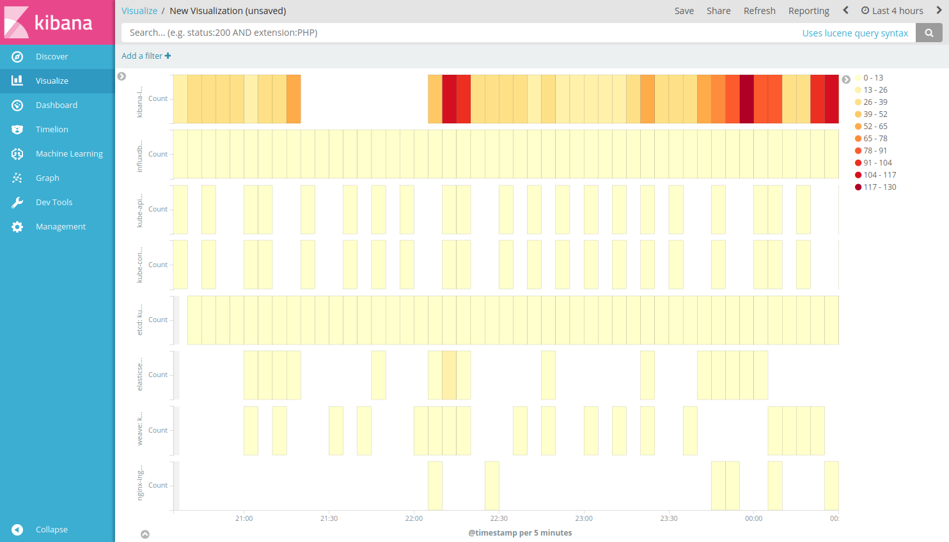
Kibana logging
oh …
you
are
hot !

Slide 80
Kibana logging
Your turn to get burnt !
Exercise#1: create previous Heat Map:
horizontal: time buckets
vertical: container names
color (heat): log count

Slide 81
Kibana logging
This slide is intentionally left blank
(as blank as your brain can become trying to use Kibana UI …)

Slide 82
III - Monitoring
Deploying and using Prometheus and Grafana

Slide 83
Monitoring
Broad classification
BlackBox (success|fail) for
alerting: «what»
examples: nagios and derivatives, DIY http/ping scripts
WhiteBox (metrics) for
alerting: «why»
latency, traffic, errors, saturation
trending / capacity planning
understanding application behavior on runtime, debugging
examples: statds+graphite, influxdb, prometheus

Slide 84
Monitoring
Pipeline consists of ~5 different phases (source):
1- Collection
2- Ingestion:
gathering, can be found via ServiceDiscovery
3- Storage:
into TSDB
4- Processing:
at ingestion
at querying
5- Visualization
queries, dashboard(s)

Slide 85
Monitoring with Prometheus
Prometheus.io is an open source, metrics-based monitoring system
Simple and powerful data model
Architecture and query language based on Google’s internal “Borgmon”
Metrics exposed as simple text lines .. try it ! ->
Run $ kubectl proxy $ kubectl get no -oname|sed s,node/,,
Visit http://localhost:8001/api/v1/nodes/NODENAME/proxy/metrics
A metric sample is composed of:
metric_name | labels {k=v} | @timestamp | value
id
value

Slide 86

Monitoring with Prometheus
Ingestion
Push Gateway
It’s typically deployed as stack of:
Prometheus +
Grafana +
Alert Manager +
(many) *-exporter
Ingestion:
pull or push
Storage:
time series DB
Processing
at ingestion and/or query time
*-exporter
Prometheus
Grafana
Alert Manager

Slide 87
Prometheus metrics
Metrics types:
Gauge:
single numerical value that can arbitrarily go up and down.
e.g.: memory usage, disk usage, temperature
Counter:
cumulative metric that represents a single numerical value that only ever goes up
e.g.: total number of requests and/or errors
Histogram/Summary:
bucketized sample observations over ranges/quantiles
very important for monitoring “tail” monitoring: mean? max? -> percentiles!
(900*0.010+100*0.100)/1000 => .019

Slide 88
Prometheus metrics - counter vs gauge
Q: What should an application expose for e.g. requests rate (gauge or counter) ?
Counter: http_requests_total
note it increases monotonically
“Converted” to Gauge -> rate(http_requests_total[2m])
note that the computed metric values will depend on the sampling rate
value
time
value

Slide 89
Prometheus deployment
Deploy all the monitoring components
# Deploy $ helm install stable/prometheus --name=prometheus --namespace=monitoring $ helm install stable/grafana --name=grafana --namespace=monitoring # Verify $ kubectl get pod --namespace=monitoring $ kubectl get svc--namespace=monitoring

Slide 90
Prometheus UI
and a bit of promQL
Use prometheus via portfwd
Visit: http://localhost:9090/, try some queries (promQL):
container_memory_usage_bytes
container_memory_usage_bytes{namespace!=""}
sum(container_memory_usage_bytes{namespace!=""}) by (namespace)
container_cpu_usage_seconds_total
rate(container_cpu_usage_seconds_total{namespace!=""}[5m])
sum(rate(container_cpu_usage_seconds_total{namespace!=""}[5m])) by (namespace)
$ prometheus_pod=$(kubectl get pod --namespace monitoring -l app=prometheus,component=server -o jsonpath="{.items[0].metadata.name}") $ kubectl --namespace monitoring port-forward ${prometheus_pod:?} 9090 &

Slide 91
Grafana
Let’s explore grafana ...
Use prometheus via portfwd
Visit -> http://localhost:3000/ , as “admin” with password from above -^
Add Datasource:
Settings:
Name: prometheus
Type: Prometheus
HTTP:
URL: http://prometheus-server/
$ grafana_pod=$(kubectl get pod --namespace monitoring -l app=grafana -o jsonpath="{.items[0].metadata.name}") $ grafana_secret=$(kubectl get secret --namespace monitoring grafana -o jsonpath="{.data.admin-password}" | base64 --decode ; echo) $ kubectl --namespace monitoring port-forward ${grafana_pod:?} 3000 & $ echo ${grafana_secret:?}

Slide 92
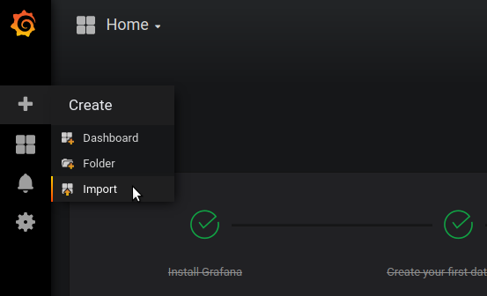
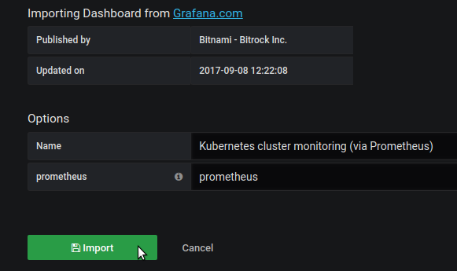
Grafana: import a dashboard
from grafana.net
From the left panel: [+] -> Import
Grafana.com dashboard
3119 ->
Select prometheus data source … and voilà
Other dashboards by bitnami:
https://github.com/bitnami-labs/kubernetes-grafana-dashboards

Slide 93
Grafana: create a dashboard
from grafana.net
From the left panel: [+] -> Create
Graph
Panel Title-> Edit
A: container_memory_usage_bytes legend format: {{ pod_name}} / {{ container_name }}
But … something’s not quite right, can you spot it ?

Slide 96
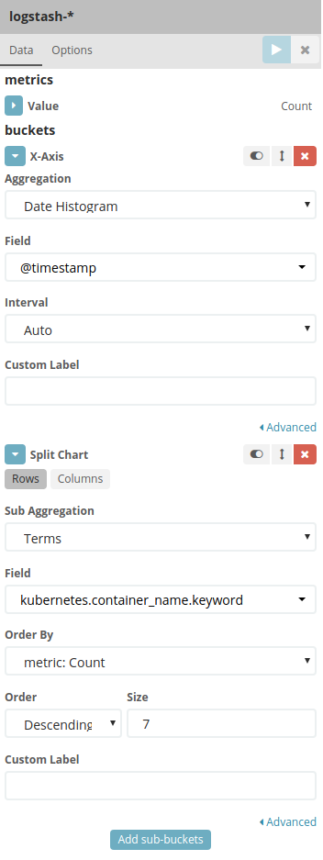
exercise#1: Kibana logging
-- Heat map solution --
[ Visualize ] -> [ Create Visualization ] -> [ Heat Map ] Index: logstash-*
X-Axis
Aggregation: Date Histogram [ Add sub-buckets ]
Split chart
Sub Aggregation : Terms
Field: kubernetes.container_name.keyword
[Play]

Slide 97
Observability: comparison
 | code instrumentation | exposed application state | aggregation level
logging | very simple e.g. log.info(...) or plain printf(...) | application log | from single log event to aggregated views
monitoring | none¹ or simple e.g. decorated functions ¹ via service mesh | application metrics e.g. http requests, latency | ingested from all instances, aggregated in query/viz
tracing | mid e.g. setting tracing marks on requests downstream | subsampled application event w/ID+timing | none - follows per request(s) end-to-end trace of events

